Slide 1
Freehand Sketch Recognition using CNN
Ronnie Antwiler Class ID#1
Nikita Goyal Class ID#7

Slide 2
MOTIVATION
Sketching has been a basic way that humans have communicated for millennia. Sketching is still used today through the digital interaction. We can draw images on iPads and laptops using digital pens or pencils. While we can draw digitally, computers can not always identify those drawings correctly. There has been research and projects on this identification process. We would like to take those existing techniques and try to improve them. Also, we would like to use methods that have not been tried in some of these projects.

Slide 3
PROJECT IDEA
We will analyze the existing techniques for analyzing and predicting sketches. The abstract nature of sketches make it difficult for a computer algorithm to identify the sketches.
The existing deep learning architectures are geared more towards real image photos instead of sketches. This has led to trying to find more convenient deep learning frameworks. Sketch-A-Net recognizes real time sketch inputs but it cannot handle large online databases.
We wish to create an app to identify what someone is drawing. We want the identification to be as accurate as we can accomplish.

Slide 4
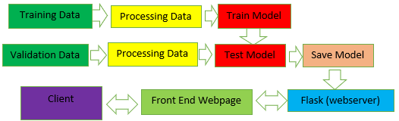
System Architecture
Data Augmentation

Slide 5
Technologies Used:
Pycharm
Jupyter Notebook
Google Colab
Flask
Sublime Text Editor

Slide 6
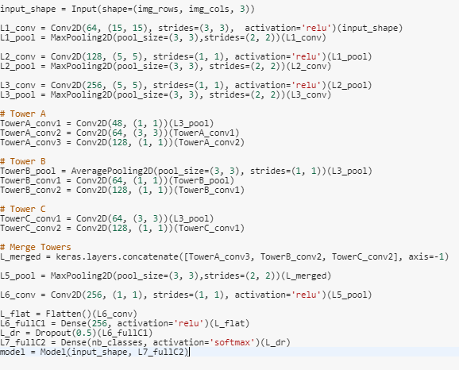
Failed Models….
We tried to create our own model but the model would not learn with the dataset.
We then tried Sketch-A-Net Model. However, it would not learn either. Even though the Sketch-A-Net was created for this dataset.

Slide 7
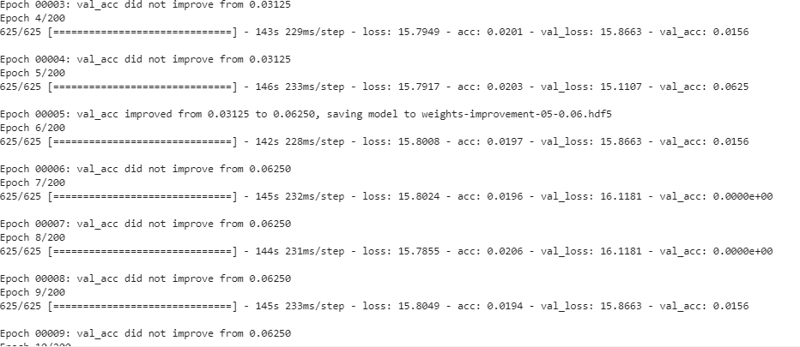
Failed Model…

Slide 8
Pretrained Models
We froze the base model layers for VGG16 and VGG19 . InceptionV3, ResNet50, and Xception did not have frozen base model layers. Frozen means the layers weights will not change.
Model | Validation Accuracy | Validation Loss
VGG16 | 71.23% | 2.77%
VGG19 | 71.03% | 2.38%
InceptionV3 | 71.63% | 2.16%
ResNet50 | 69.35% | 2.33%
Xception | 74.90% | 1.83%

Slide 9
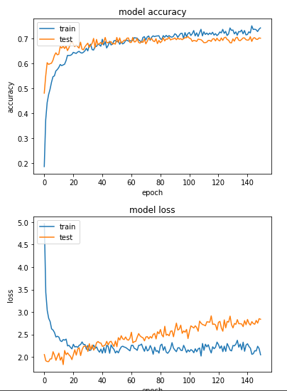
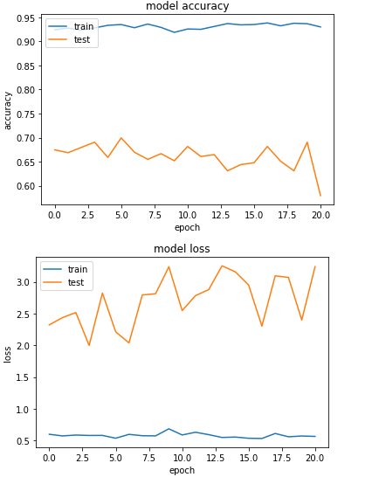
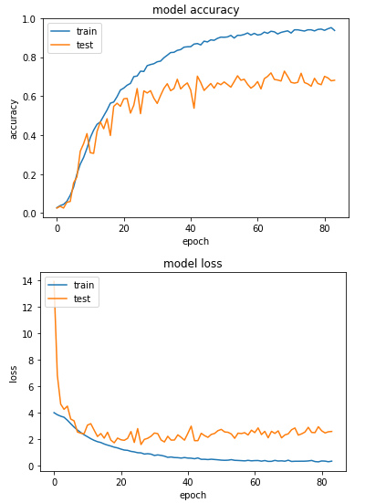
VGG16
InceptionV3
ResNet50

Slide 10
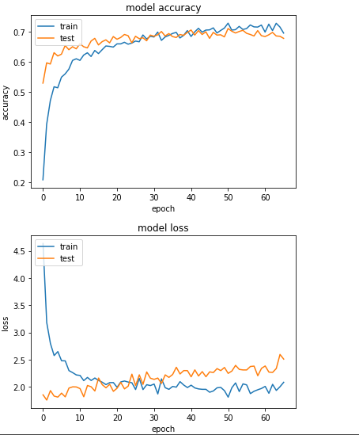
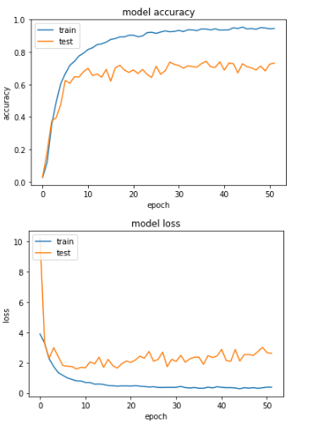
VGG19
XCeption

Slide 11
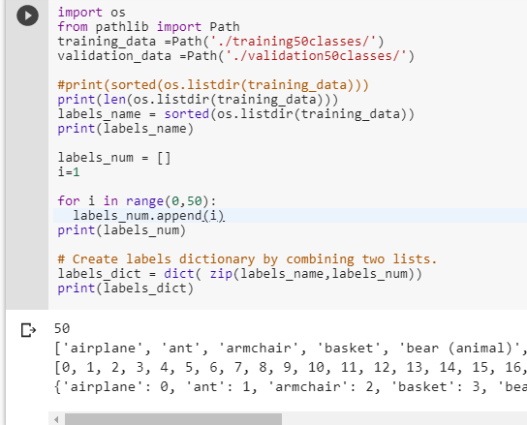
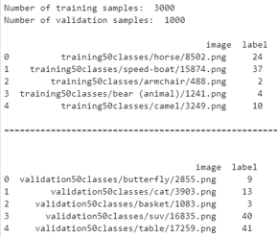
VGG16
VGG16 has 16 layers and was designed to classify 1000 classes.
The TU-Berlin Dataset has 250 classes and 20,000 images. We reduced it to 50 classes. We then split the data into validation and training. This gave us 3000 training images and 1000 validation samples.

Slide 12
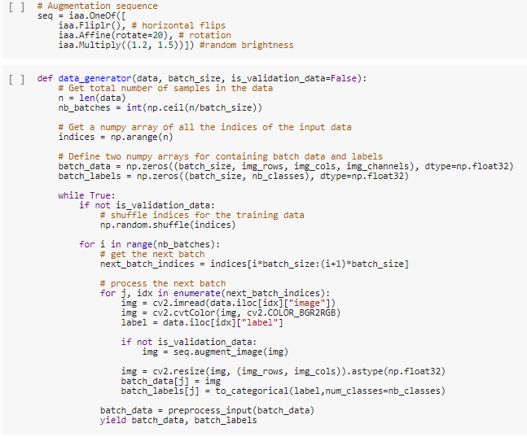
Data Processing
Data augmentation: Flip Horizontal, Change Rotation, Change Brightness, Divide Data by 255 to normalize
Original Image size was 1,111 x 1,111. We used 150 epochs, 16 batch size and image size of 224 x 224.

Slide 13
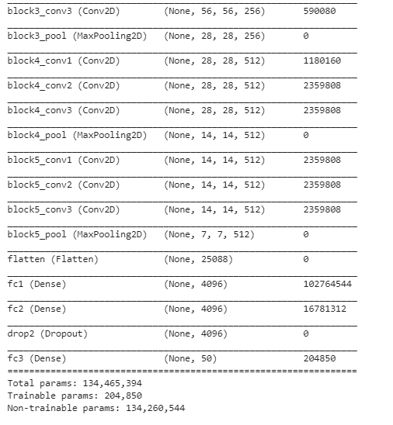
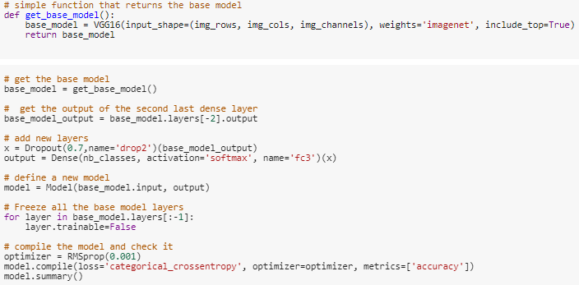
We kept the base VGG16 model the same except we removed the output layer for 1000 classes and added an output layer to the do 50 classes.
We also set the trainable parameter to False for the base model layers.

Slide 14
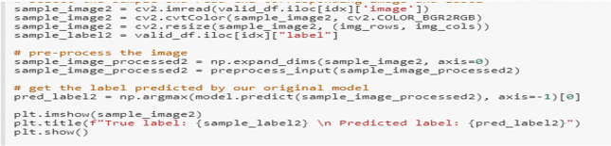
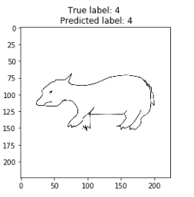
Prediction

Slide 15
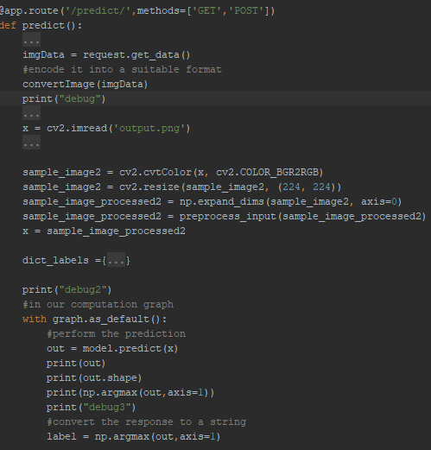
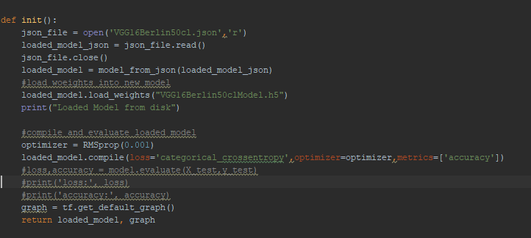
Flask
Flask is micro web framework written in Python

Slide 16
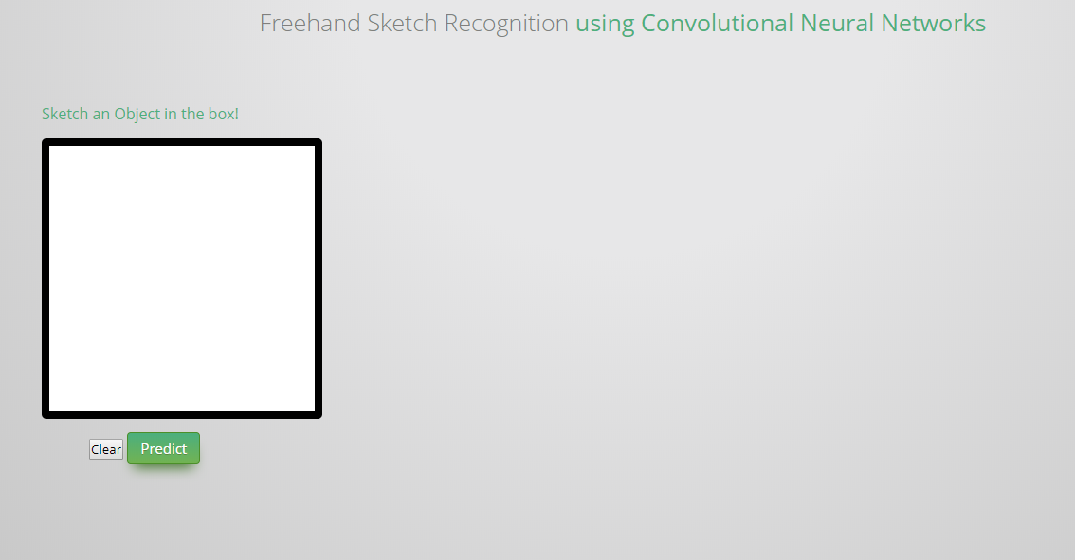
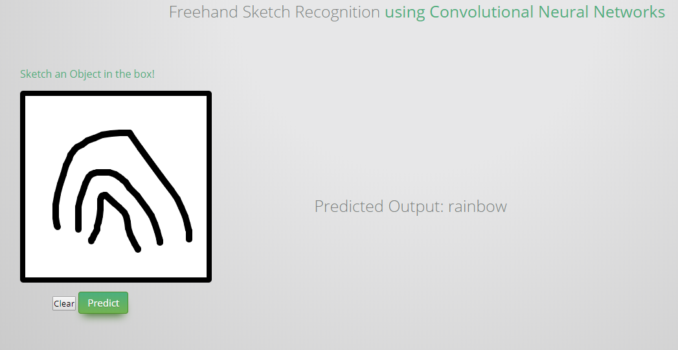
Webpage with Prediction

Slide 17
Demo

Slide 18
Future work
Figure out the Dataset better and why we were not able to reproduce others’ results.
Continue to try to find better accuracy with 250 classes and not 50 classes.
The best accuracy for these sketches is in the mid-80s percent. There is still room for improvement.

Slide 19
Thank you

